Slide 1
IOTSSC Project presentation

Slide 2
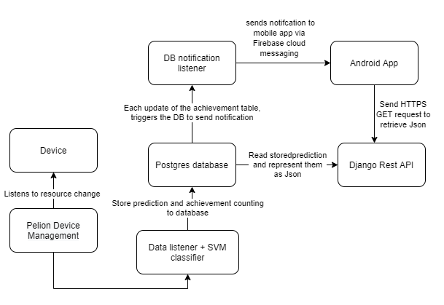
Communication design

Slide 3
Technical challenge faced
Setting up App engine and Cloud SQL
Pelion REST APIs Using HTTP PUT
Creation of triggers
Android app async HTTPS tasks
Android app foreground and background notification

Slide 4
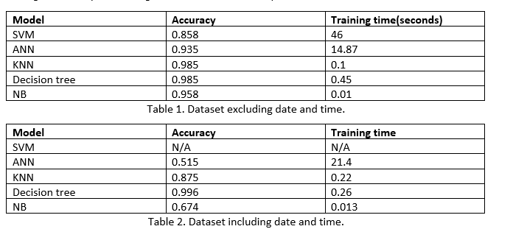
Classifier

Slide 5
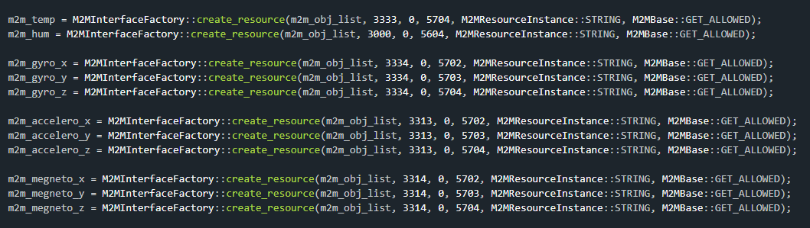
Firmware

Slide 6
Cloud Server
PostgreSQL Database
Pelion API request script
Django API
Push notification script

Slide 7
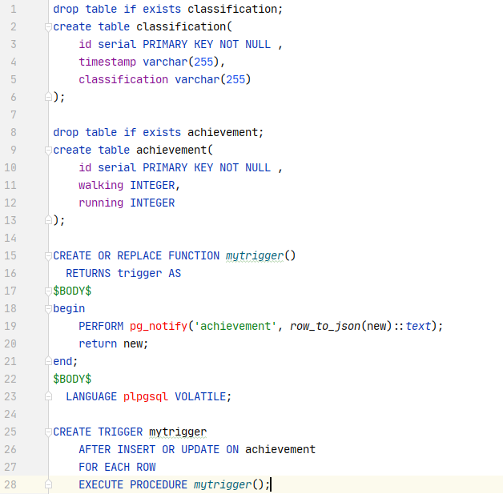
Database

Slide 8
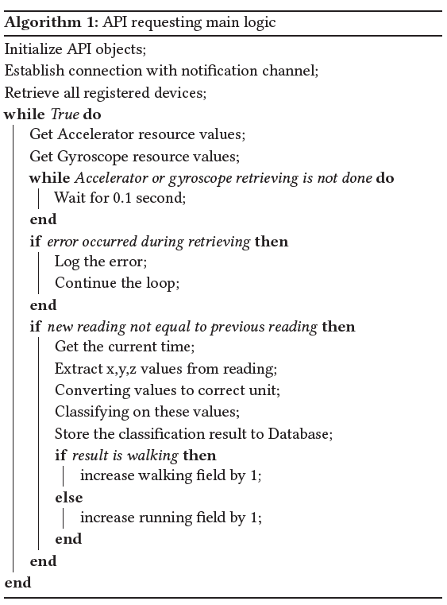
Pelion API request script

Slide 9
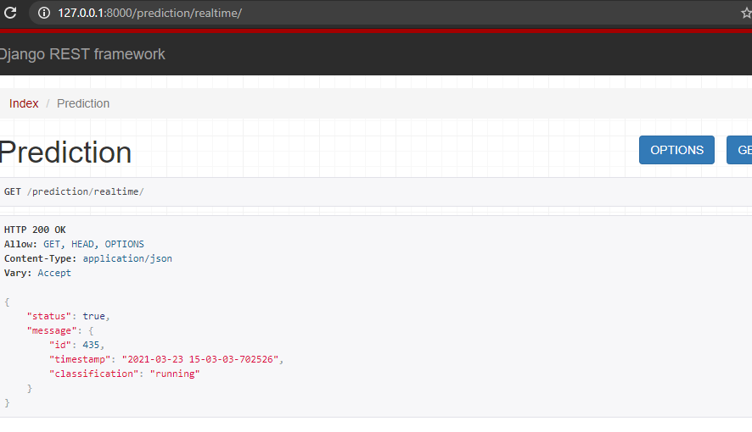
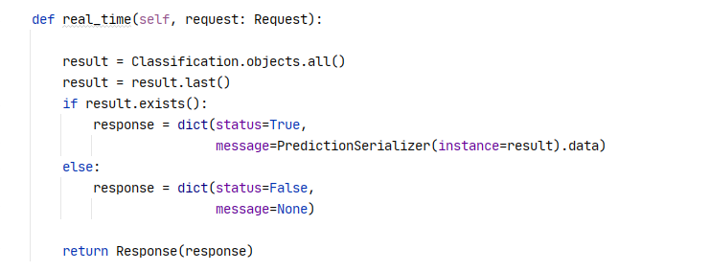
Django API

Slide 10
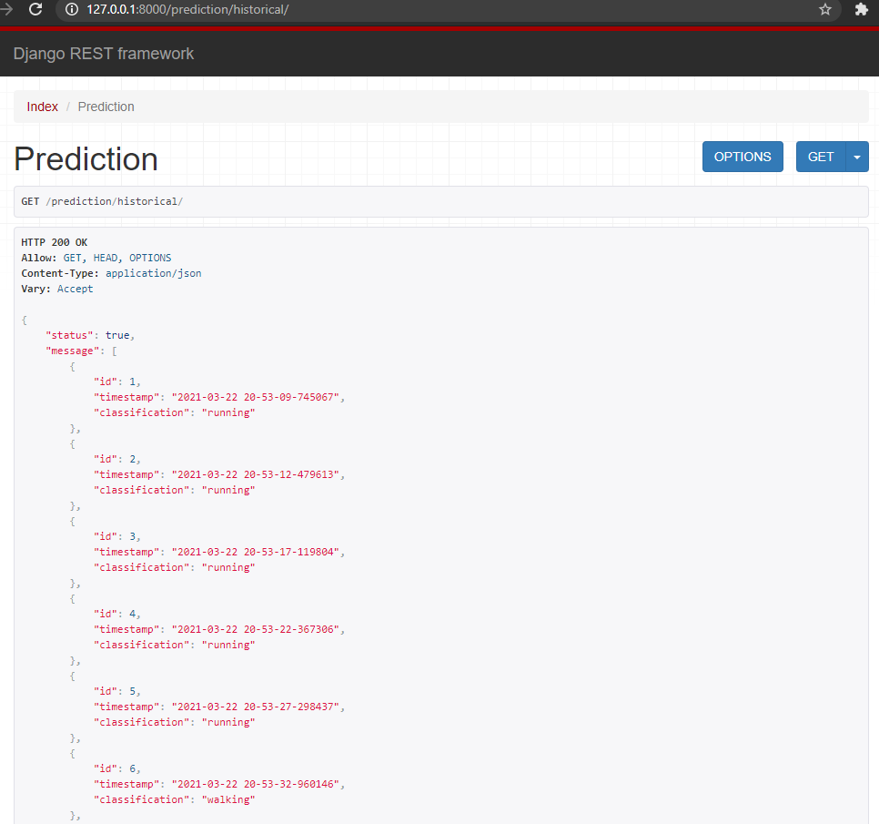
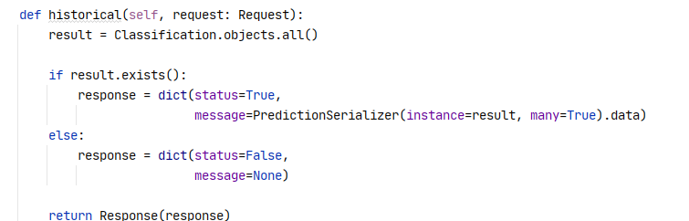

Slide 11
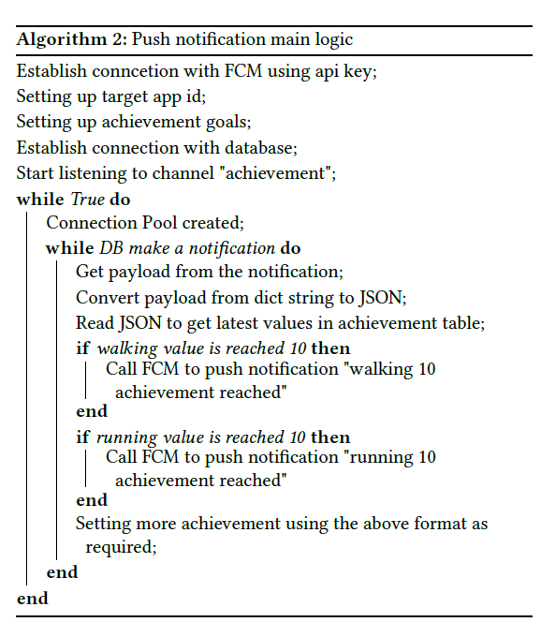
Push notification script

Slide 12
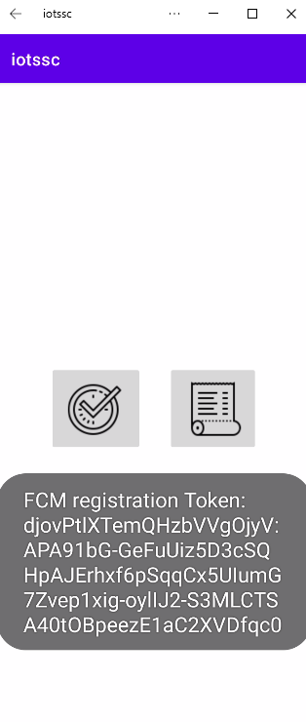
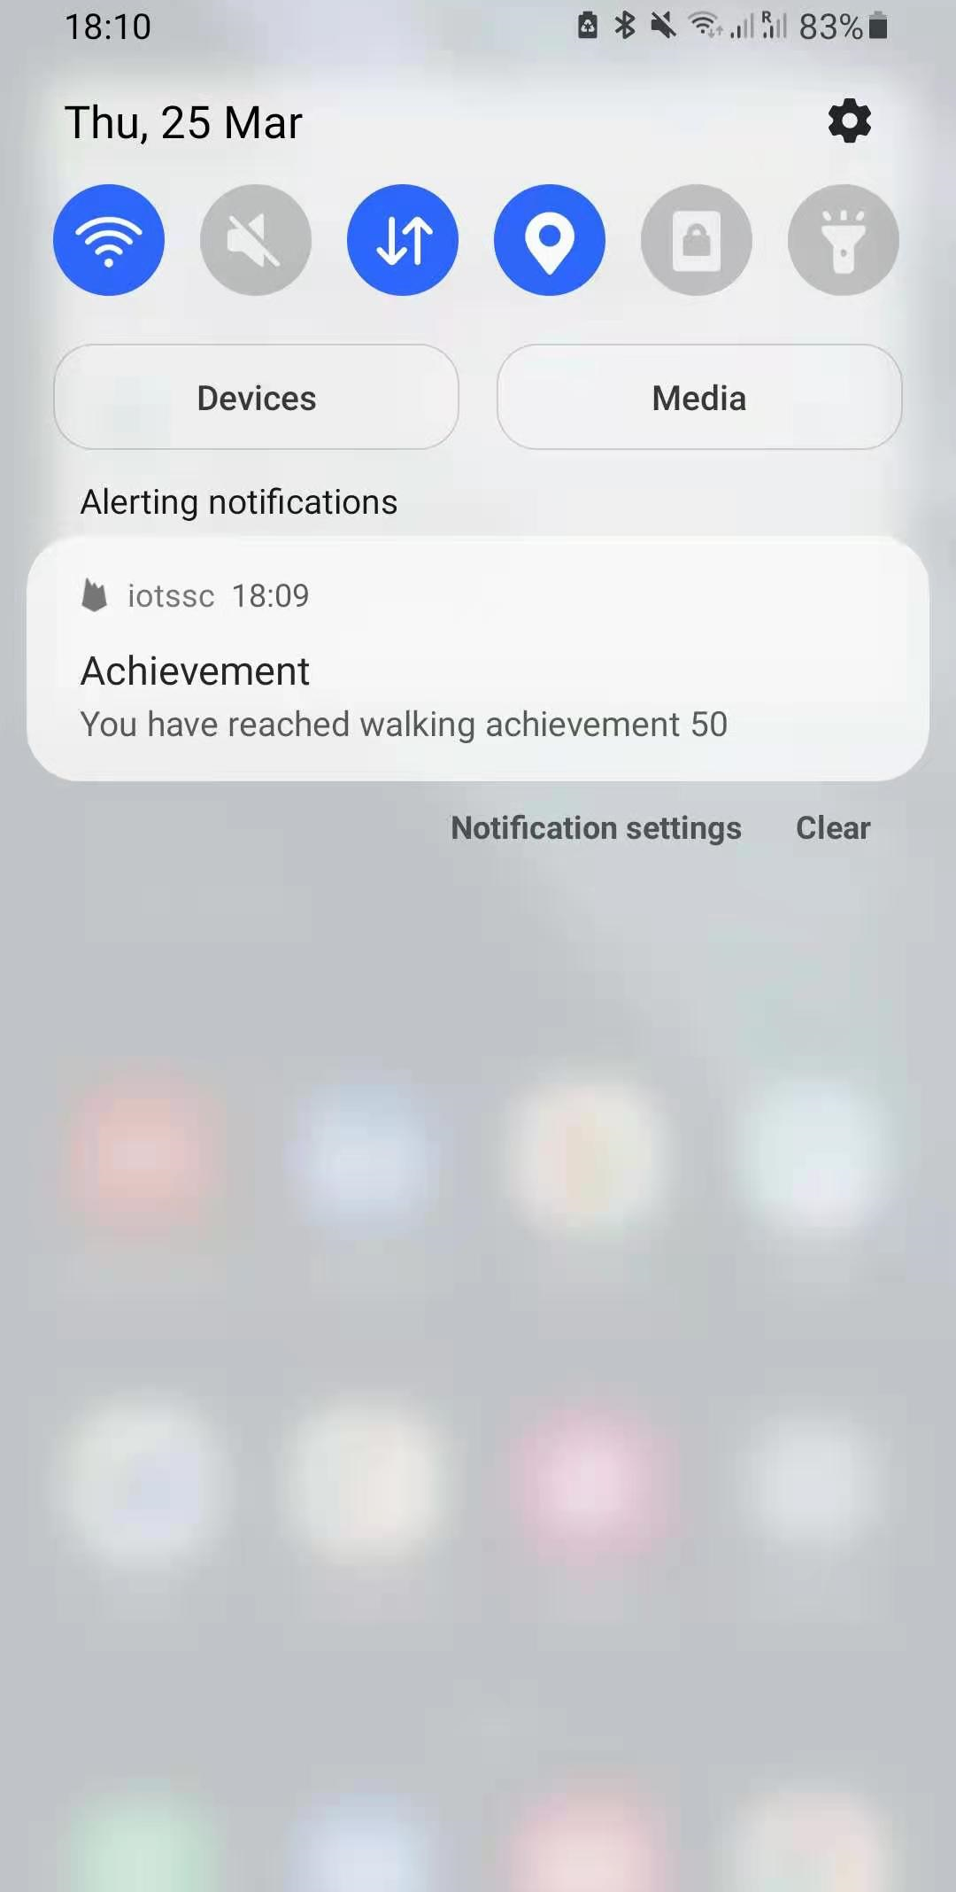
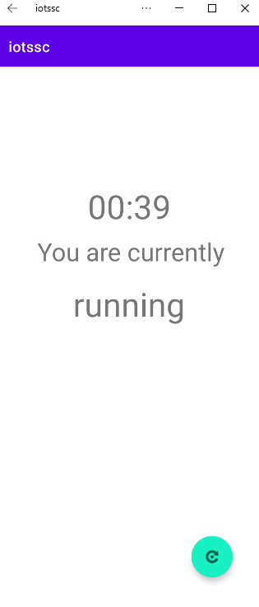
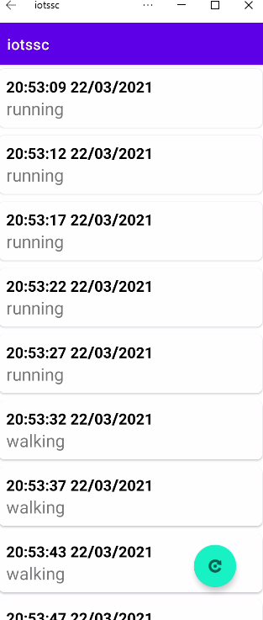
Android App

Slide 13
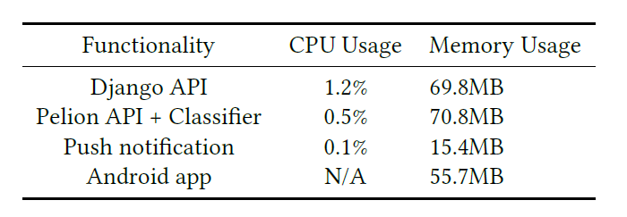
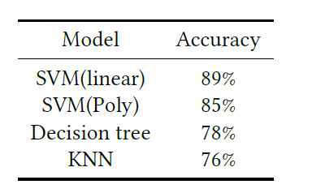
Evaluation
CPU and Memory Usage
Prediction accuracy on real-life data
Security
HTTPS and token authorization
Other components are managed by platforms

